Slide 1
Website Requirements
SAGAR VYAS
3rd April 2025

Slide 2


Hero Section - Title
Confirm or Suggest Title text
Confirm or Suggest Sub-Title text

Slide 3

Hero Section - Image
Sunny Evening or late afternoon time outside
Must have blinds behind which are open
If possible, big eye glasses
Wide-Smile on face. Looking away from camera. Person looks trustworthy
Trees in background with sunlight gives nice feel
Some files on a drawer behind
Doctor’s attire
A tab in hands
Office desk with
PC
Get Exactly similar photograph clicked
Half-sitting position on desk
Blurry background

Slide 4
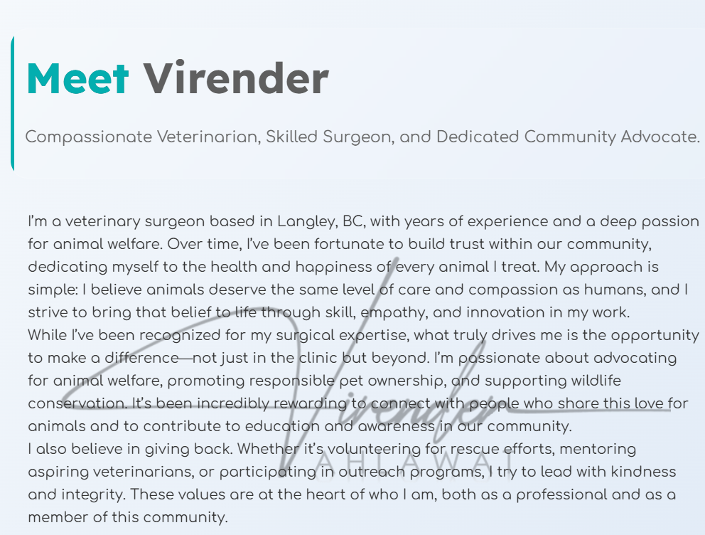
About Section - Text
How many years of experience?

Slide 5

About Section - Image
Blurry background. Preferably sunny in a garden
Up close portrait. Only upper body
Casual Formal clothing
Get similar portrait photograph clicked
Wide smile

Slide 6
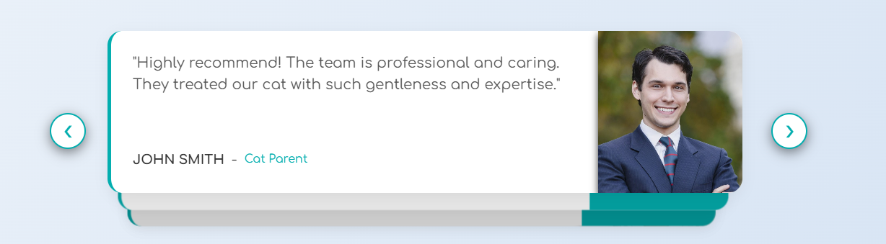
About Section - Testimonials
Pick and share Best 7-10 reviews from google where Name and photograph of reviewer are available.
I would prefer picking reviews of long-term regular clients. One, they won’t object using their photograph here, second, we know they have cat or dog or any other pet

Slide 7

Journey Section - Text
Provide all educational qualifications with Year and University

Slide 8

Journey Section - Text
Provide all Professional milestones including any important certifications with Year and Organization where milestone achieved

Slide 9
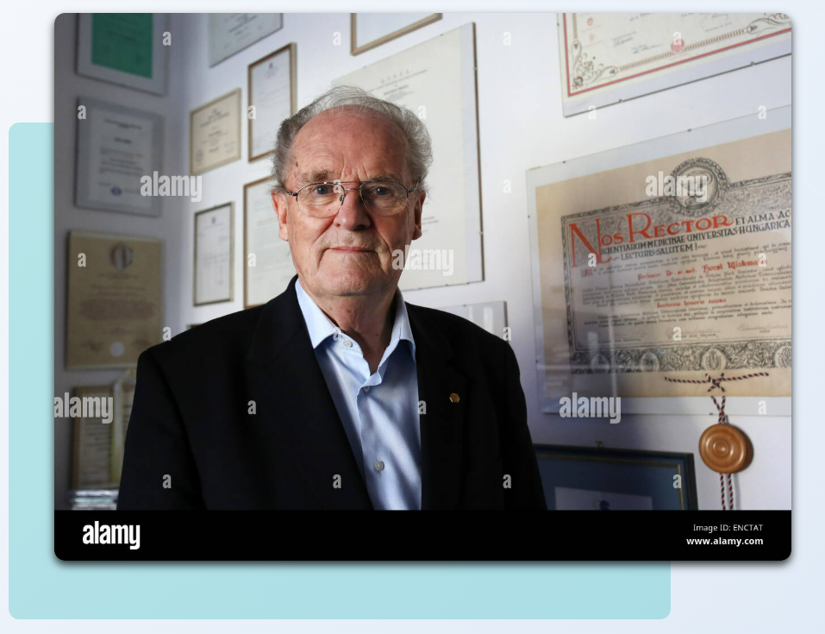
Journey Section - Image
Show wall hanging degrees or certificates
Get similar photograph clicked
Any Formal Attire

Slide 10

Metrics Section
Provide following:
Your years of experience
How many successful surgeries you have completed – 14k+
Total number of clients you have plus which you had in past – 6k+
How many awards, Certifications or recognitions you have won -

Slide 11
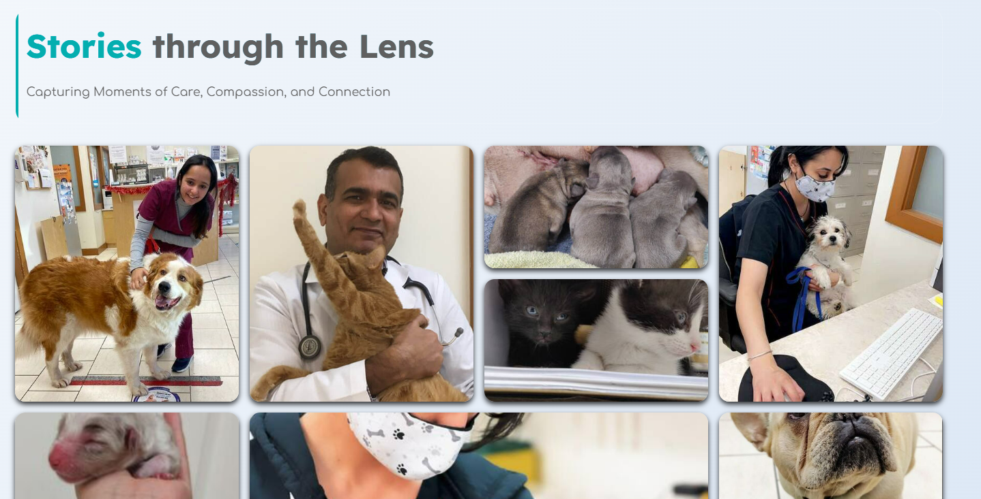
Gallery Section
Provide more photographs of you and a happy customer(preferably with pet). Also provide a 1-2 liner description for the photograph

Slide 12
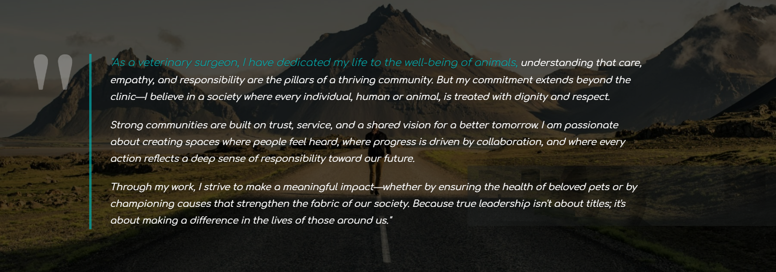
Vision Section
Provide 2-3 paragraphs about what is your vision for the society, for community. I’ve added this text. If you like it, we can keep this as well. Or you can use this text as a base for your own thoughts

Slide 13
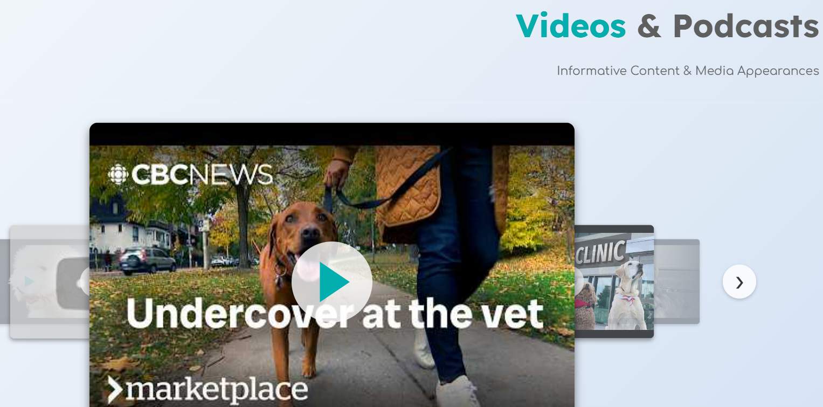
Videos Section
Currently on the website, I can display youtube videos only. Create your own youtube channel. Post all your available videos/reels there and provide me link of all of them

Slide 14
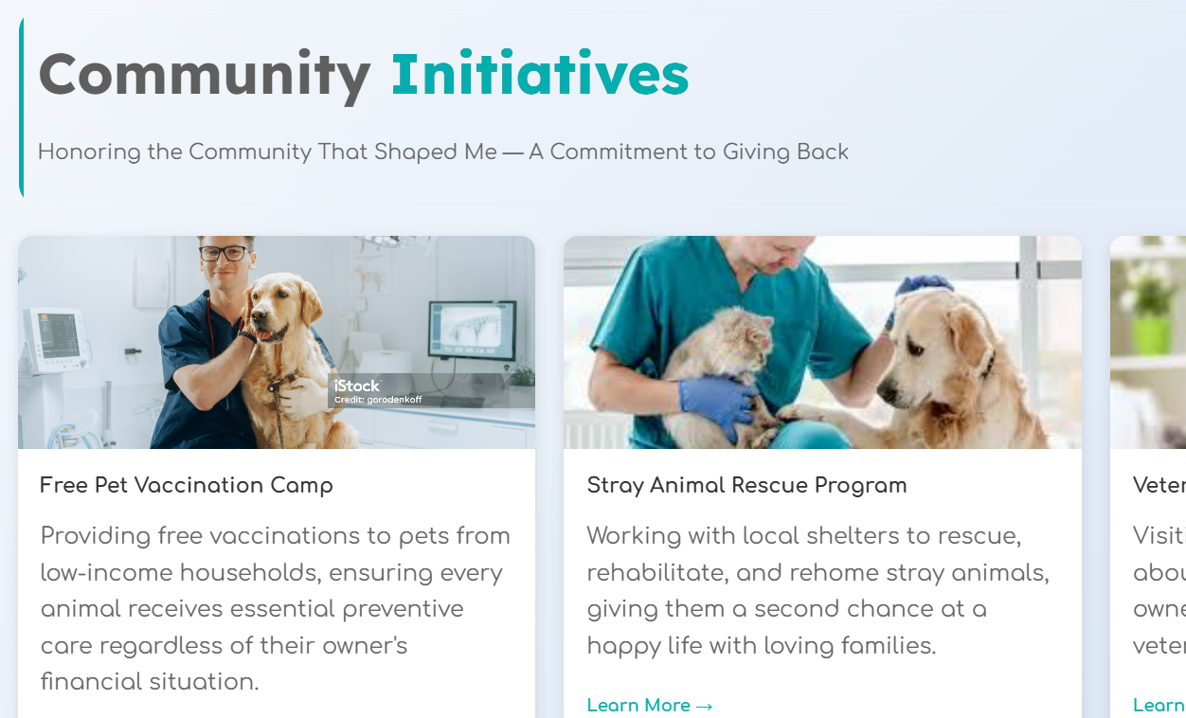
Community Initiatives Section
Provide 1-2 paragraphs about 2 to 3 community initiatives you have participated or organized. Also provide any photograph related to that initiative/event

Slide 15
Blogs Section
I visited your pet hospital website and read through all the blogs. I noticed that they are primarily technical, focusing on diseases, procedures, treatment costs, and how your clinic can assist pet owners.
However, for the blog section on this website, our goal should be different. Instead of medical and procedural topics, we should explore broader, more personal themes related to pets. What are the common challenges pet owners face that go beyond medical concerns? How do pets shape our lives, families, and society?
Through these blogs, I want people to connect with you not just as a veterinary professional but as a person who deeply cares about animals, their well-being, and their relationships with humans. Your thoughts on pets, their emotional lives, and the role of pet parents can create a meaningful bond with your audience.

Slide 16
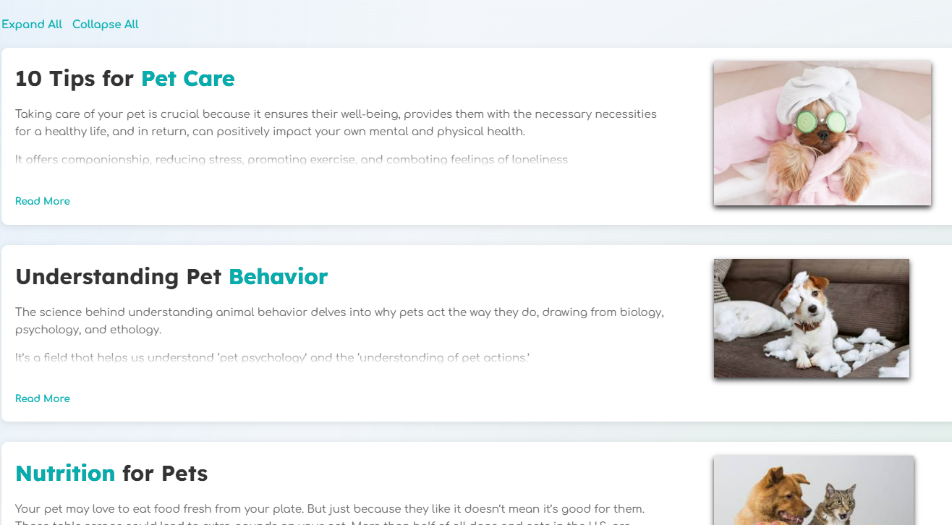
Blogs Section
Provide 5-6 blogs. Keep length of each around 2-3 paragraphs
I’ll find related photographs
Write the blogs in a word document so that you can easily add bulletpoints or make any text bold/italics etc. I’ll replicate same while posting them on website.

Slide 17
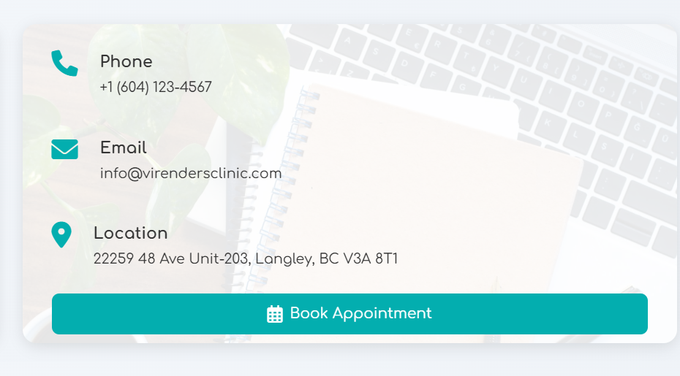
Appointment Booking
Create an account on https://calendly.com/
Use that email id for account creation which you want to you want to use for managing calendar and receive customer booking request emails

